Slide 1
Basic Communication Operations
JSPM’s Sawant Institute of Technology and Research,
Wagholi,Pune-412207
Department of Computer Engineering
Presented By: Prof . Vijay D. Sonawane

Slide 2
Institute & MissionDepartment Vision
Institute Vision
"Satisfy the aspirations of youth force, who want to lead nation towards prosperity through techno-economic development."
Institute Mission
“To provide, nurture and maintain an environment of high academics excellence, research and entrepreneurship for all aspiring students, which will prepare them to face global challenges maintaining high ethical and moral standards.“
Departmental Vision
“Empowering the students to be professionally competent & socially responsible for techno- economic development of society.”
Departmental Mission
A: To provide quality education enabling students for higher studies, research and entrepreneurship
B: To inculcate professionalism and ethical values through day to day practices.

Slide 3
Topic Overview
One-to-All Broadcast and All-to-One Reduction
All-to-All Broadcast and Reduction
All-Reduce and Prefix-Sum Operations
Scatter and Gather
All-to-All Personalized Communication
Circular Shift
Improving the Speed of Some Communication Operations

Slide 4
Basic Communication Operations: Introduction
Many interactions in practical parallel programs occur in well-defined patterns involving groups of processors.
Efficient implementations of these operations can improve performance, reduce development effort and cost, and improve software quality.
Efficient implementations must leverage underlying architecture. For this reason, we refer to specific architectures here.
We select a descriptive set of architectures to illustrate the process of algorithm design.

Slide 5
Basic Communication Operations: Introduction
Group communication operations are built using point-to-point messaging primitives.
Recall from our discussion of architectures that communicating a message of size m over an uncongested network takes time t_{s} +t_{m}w.
We use this as the basis for our analyses. Where necessary, we take congestion into account explicitly by scaling the t_{w} term.
We assume that the network is bidirectional and that communication is single-ported.

Slide 6
One-to-All Broadcast and All-to-One Reduction
One processor has a piece of data (of size m) it needs to send to everyone.
The dual of one-to-all broadcast is all-to-one reduction.
In all-to-one reduction, each processor has m units of data. These data items must be combined piece-wise (using some associative operator, such as addition or min), and the result made available at a target processor.

Slide 7
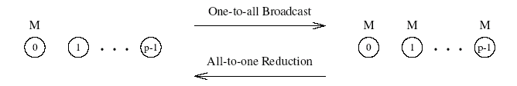
One-to-All Broadcast and All-to-One Reduction
One-to-all broadcast and all-to-one reduction among processors.

Slide 8
One-to-All Broadcast and All-to-One Reduction on Rings
Simplest way is to send p-1 messages from the source to the other p-1 processors - this is not very efficient.
Use recursive doubling: source sends a message to a selected processor. We now have two independent problems derined over halves of machines.
Reduction can be performed in an identical fashion by inverting the process.

Slide 9
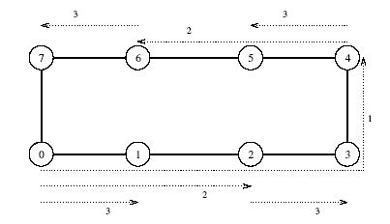
One-to-All Broadcast
One-to-all broadcast on an eight-node ring. Node 0 is the source of the broadcast. Each message transfer step is shown by a numbered, dotted arrow from the source of the message to its destination. The number on an arrow indicates the time step during which the message is transferred.

Slide 10
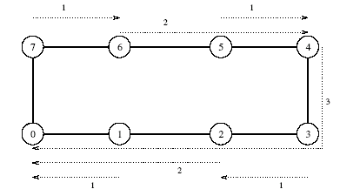
All-to-One Reduction
Reduction on an eight-node ring with node 0 as the destination of the reduction.

Slide 11
Broadcast and Reduction: Example
Consider the problem of multiplying a matrix with a vector.
The n x n matrix is assigned to an n x n (virtual) processor grid. The vector is assumed to be on the first row of processors.
The first step of the product requires a one-to-all broadcast of the vector element along the corresponding column of processors. This can be done concurrently for all n columns.
The processors compute local product of the vector element and the local matrix entry.
In the final step, the results of these products are accumulated to the first row using n concurrent all-to-one reduction operations along the columns (using the sum operation).

Slide 12
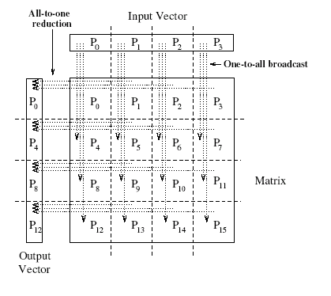
Broadcast and Reduction: Matrix-Vector Multiplication Example
One-to-all broadcast and all-to-one reduction in the multiplication of a 4 x 4 matrix with a 4 x 1 vector.

Slide 13
Broadcast and Reduction on a Mesh
We can view each row and column of a square mesh of p nodes as a linear array of √p nodes.
Broadcast and reduction operations can be performed in two steps - the first step does the operation along a row and the second step along each column concurrently.
This process generalizes to higher dimensions as well.

Slide 14
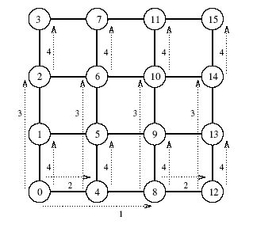
Broadcast and Reduction on a Mesh: Example
One-to-all broadcast on a 16-node mesh.

Slide 15
Broadcast and Reduction on a Hypercube
A hypercube with 2^{d} nodes can be regarded as a d-dimensional mesh with two nodes in each dimension.
The mesh algorithm can be generalized to a hypercube and the operation is carried out in d (= log p) steps.

Slide 16
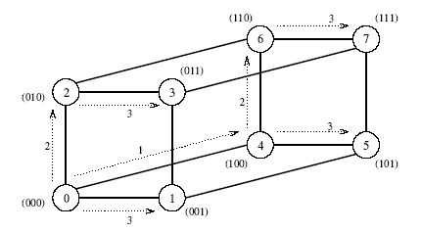
Broadcast and Reduction on a Hypercube: Example
One-to-all broadcast on a three-dimensional hypercube. The binary representations of node labels are shown in parentheses.

Slide 17
Broadcast and Reduction on a Balanced Binary Tree
Consider a binary tree in which processors are (logically) at the leaves and internal nodes are routing nodes.
Assume that source processor is the root of this tree. In the first step, the source sends the data to the right child (assuming the source is also the left child). The problem has now been decomposed into two problems with half the number of processors.

Slide 18
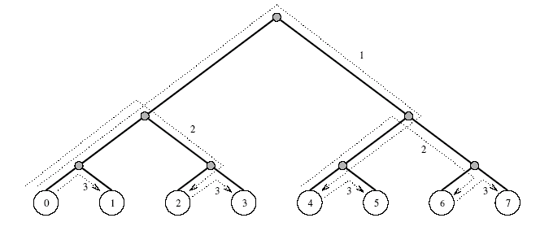
Broadcast and Reduction on a Balanced Binary Tree
One-to-all broadcast on an eight-node tree.

Slide 19
Broadcast and Reduction Algorithms
All of the algorithms described above are adaptations of the same algorithmic template.
We illustrate the algorithm for a hypercube, but the algorithm, as has been seen, can be adapted to other architectures.
The hypercube has 2^{d} nodes and my_id is the label for a node.
X is the message to be broadcast, which initially resides at the source node 0.

Slide 20
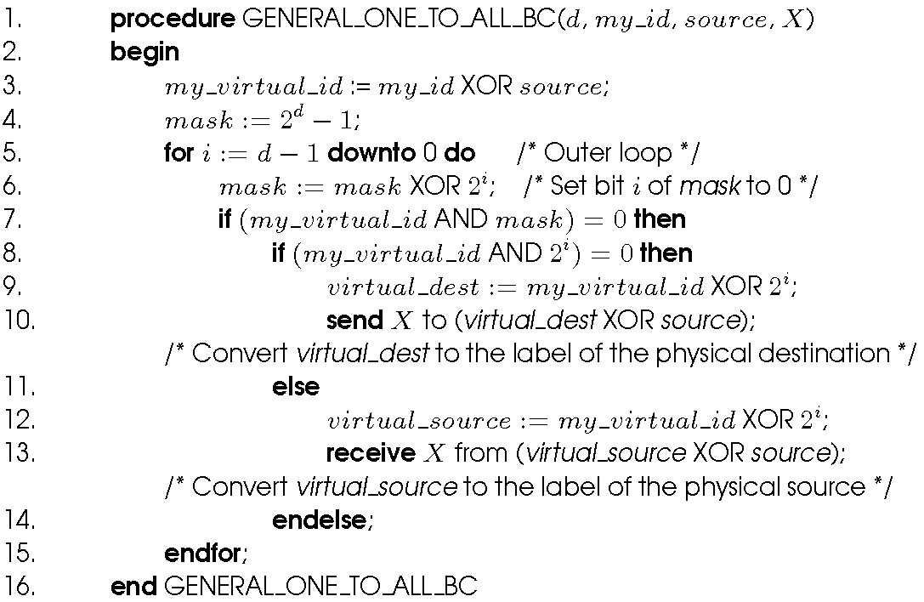
Broadcast and Reduction Algorithms
One-to-all broadcast of a message X from source on a hypercube.

Slide 21
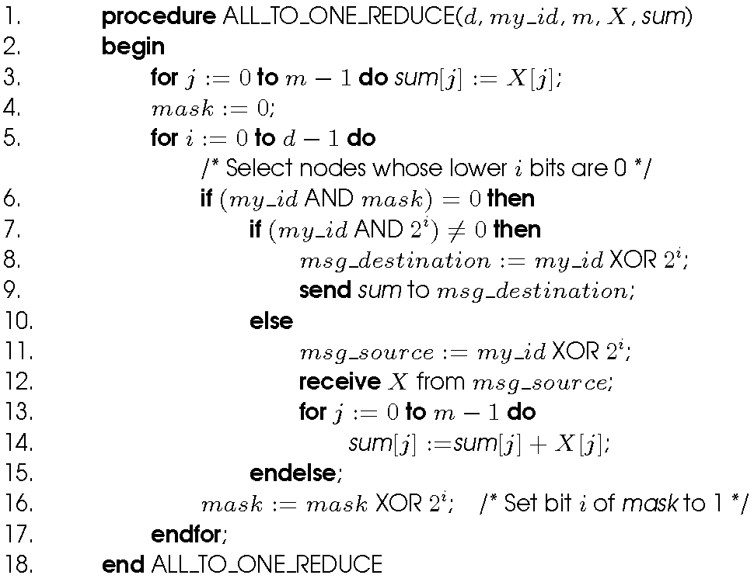
Broadcast and Reduction Algorithms
Single-node accumulation on a d-dimensional hypercube. Each node contributes a message X containing m words, and node 0 is the destination.

Slide 22

Cost Analysis
The broadcast or reduction procedure involves log p point-to-point simple message transfers, each at a time cost of t_{s} + t_{w}m.
The total time is therefore given by:

Slide 23
All-to-All Broadcast and Reduction
Generalization of broadcast in which each processor is the source as well as destination.
A process sends the same m-word message to every other process, but different processes may broadcast different messages.

Slide 24
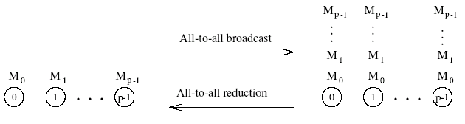
All-to-All Broadcast and Reduction
All-to-all broadcast and all-to-all reduction.

Slide 25
All-to-All Broadcast and Reduction on a Ring
Simplest approach: perform p one-to-all broadcasts. This is not the most efficient way, though.
Each node first sends to one of its neighbors the data it needs to broadcast.
In subsequent steps, it forwards the data received from one of its neighbors to its other neighbor.
The algorithm terminates in p-1 steps.

Slide 26
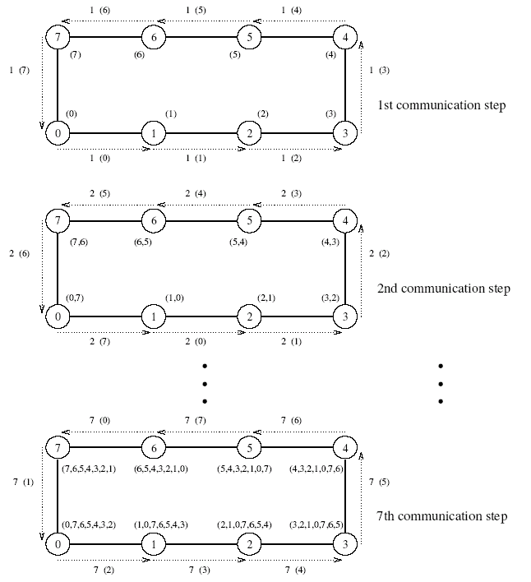
All-to-All Broadcast and Reduction on a Ring
All-to-all broadcast on an eight-node ring.

Slide 27
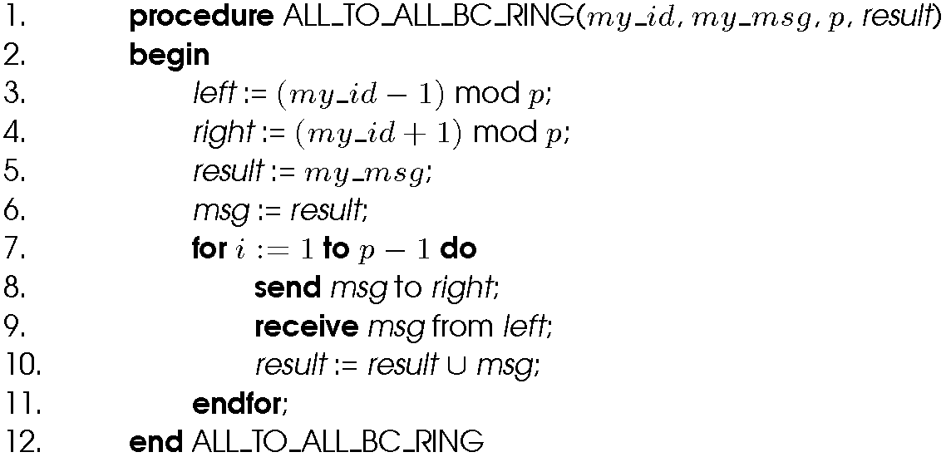
All-to-All Broadcast and Reduction on a Ring
All-to-all broadcast on a p-node ring.

Slide 28
All-to-all Broadcast on a Mesh
Performed in two phases - in the first phase, each row of the mesh performs an all-to-all broadcast using the procedure for the linear array.
In this phase, all nodes collect √p messages corresponding to the √p nodes of their respective rows. Each node consolidates this information into a single message of size m√p.
The second communication phase is a columnwise all-to-all broadcast of the consolidated messages.

Slide 29
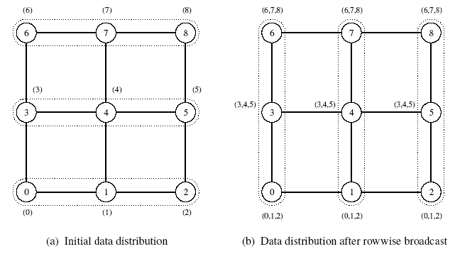
All-to-all Broadcast on a Mesh
All-to-all broadcast on a 3 x 3 mesh. The groups of nodes communicating with each other in each phase are enclosed by dotted boundaries. By the end of the second phase, all nodes get (0,1,2,3,4,5,6,7) (that is, a message from each node).

Slide 30
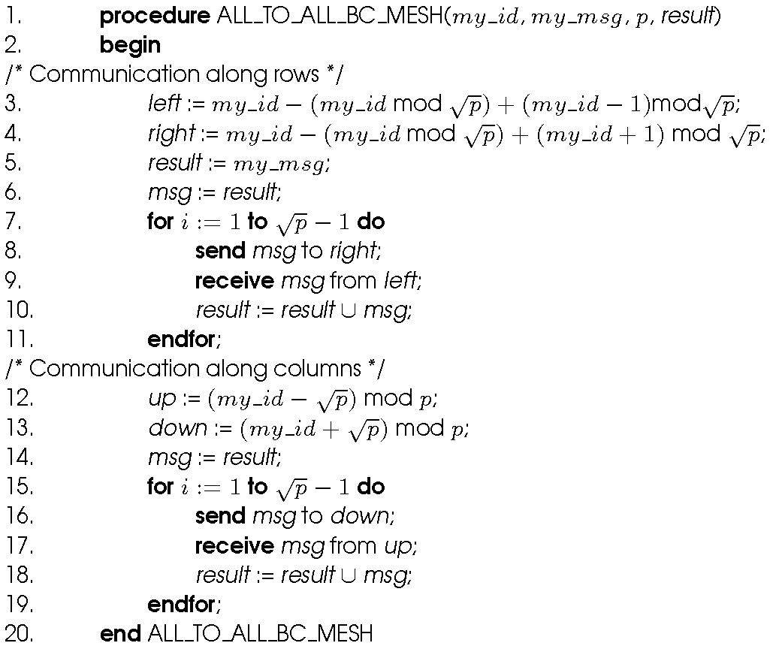
All-to-all Broadcast on a Mesh
All-to-all broadcast on a square mesh of p nodes.

Slide 31
All-to-all broadcast on a Hypercube
Generalization of the mesh algorithm to log p dimensions.
Message size doubles at each of the log p steps.

Slide 32
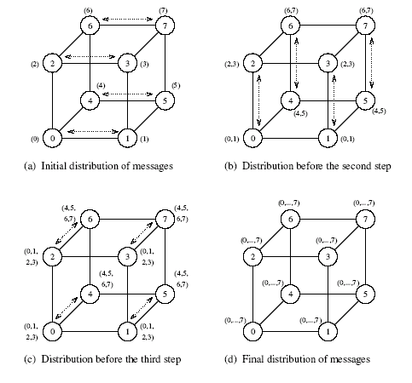
All-to-all broadcast on a Hypercube
All-to-all broadcast on an eight-node hypercube.

Slide 33
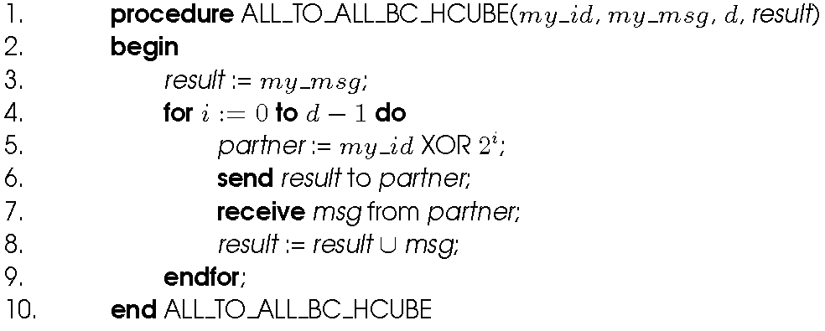
All-to-all broadcast on a Hypercube
All-to-all broadcast on a d-dimensional hypercube.

Slide 34
All-to-all Reduction
Similar communication pattern to all-to-all broadcast, except in the reverse order.
On receiving a message, a node must combine it with the local copy of the message that has the same destination as the received message before forwarding the combined message to the next neighbor.

Slide 35
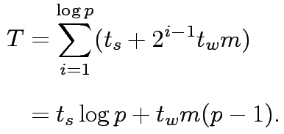
Cost Analysis
On a ring, the time is given by: (t_{s} + t_{w}m)(p-1).
On a mesh, the time is given by: 2t_{s}(√p – 1) + t_{w}m(p-1).
On a hypercube, we have:

Slide 36
All-to-all broadcast: Notes
All of the algorithms presented above are asymptotically optimal in message size.
It is not possible to port algorithms for higher dimensional networks (such as a hypercube) into a ring because this would cause contention.

Slide 37
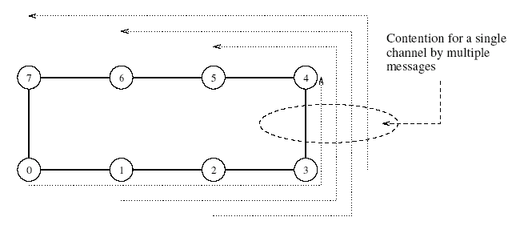
All-to-all broadcast: Notes
Contention for a channel when the hypercube is mapped onto a ring.

Slide 38
All-Reduce and Prefix-Sum Operations
In all-reduce, each node starts with a buffer of size m and the final results of the operation are identical buffers of size m on each node that are formed by combining the original p buffers using an associative operator.
Identical to all-to-one reduction followed by a one-to-all broadcast. This formulation is not the most efficient. Uses the pattern of all-to-all broadcast, instead. The only difference is that message size does not increase here. Time for this operation is (t_{s} + t_{w}m) log p.
Different from all-to-all reduction, in which p simultaneous all-to-one reductions take place, each with a different destination for the result.

Slide 39
The Prefix-Sum Operation
Given p numbers n₀,n₁,…,n_{p-1} (one on each node), the problem is to compute the sums s_{k} = ∑_{i}^{k}₌ ₀ n_{i} for all k between 0 and p-1 .
Initially, n_{k} resides on the node labeled k, and at the end of the procedure, the same node holds S_{k}.

Slide 40
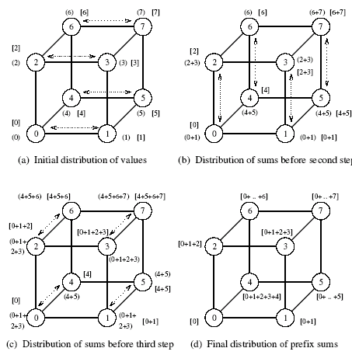
The Prefix-Sum Operation
Computing prefix sums on an eight-node hypercube. At each node, square brackets show the local prefix sum accumulated in the result buffer and parentheses enclose the contents of the outgoing message buffer for the next step.

Slide 41
The Prefix-Sum Operation
The operation can be implemented using the all-to-all broadcast kernel.
We must account for the fact that in prefix sums the node with label k uses information from only the k-node subset whose labels are less than or equal to k.
This is implemented using an additional result buffer. The content of an incoming message is added to the result buffer only if the message comes from a node with a smaller label than the recipient node.
The contents of the outgoing message (denoted by parentheses in the figure) are updated with every incoming message.

Slide 42
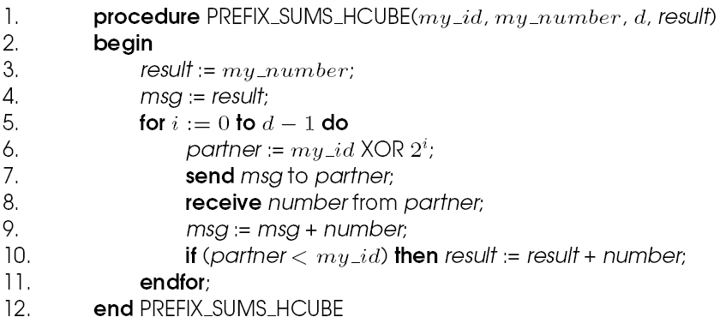
The Prefix-Sum Operation
Prefix sums on a d-dimensional hypercube.

Slide 43
Scatter and Gather
In the scatter operation, a single node sends a unique message of size m to every other node (also called a one-to-all personalized communication).
In the gather operation, a single node collects a unique message from each node.
While the scatter operation is fundamentally different from broadcast, the algorithmic structure is similar, except for differences in message sizes (messages get smaller in scatter and stay constant in broadcast).
The gather operation is exactly the inverse of the scatter operation and can be executed as such.

Slide 44
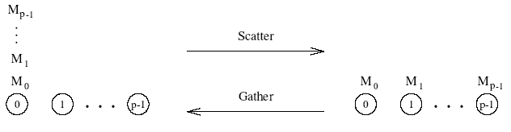
Gather and Scatter Operations
Scatter and gather operations.

Slide 45
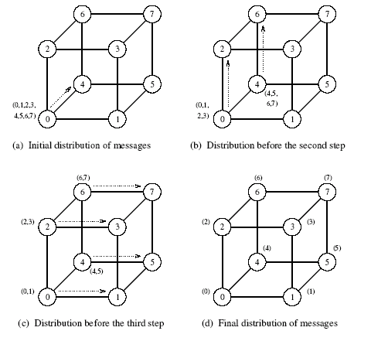
Example of the Scatter Operation
The scatter operation on an eight-node hypercube.

Slide 46

Cost of Scatter and Gather
There are log p steps, in each step, the machine size halves and the data size halves.
We have the time for this operation to be:
This time holds for a linear array as well as a 2-D mesh.
These times are asymptotically optimal in message size.

Slide 47
All-to-All Personalized Communication
Each node has a distinct message of size m for every other node.
This is unlike all-to-all broadcast, in which each node sends the same message to all other nodes.
All-to-all personalized communication is also known as total exchange.

Slide 48
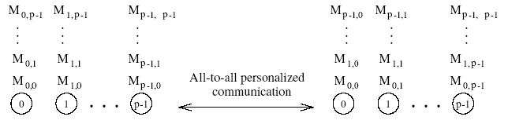
All-to-All Personalized Communication
All-to-all personalized communication.

Slide 49
All-to-All Personalized Communication: Example
Consider the problem of transposing a matrix.
Each processor contains one full row of the matrix.
The transpose operation in this case is identical to an all-to-all personalized communication operation.

Slide 50
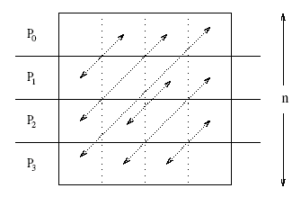
All-to-All Personalized Communication: Example
All-to-all personalized communication in transposing a 4 x 4 matrix using four processes.

Slide 51
All-to-All Personalized Communication on a Ring
Each node sends all pieces of data as one consolidated message of size m(p – 1) to one of its neighbors.
Each node extracts the information meant for it from the data received, and forwards the remaining (p – 2) pieces of size m each to the next node.
The algorithm terminates in p – 1 steps.
The size of the message reduces by m at each step.

Slide 52
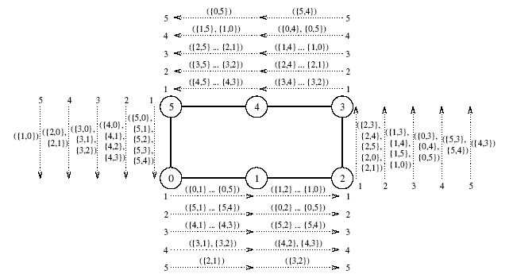
All-to-All Personalized Communication on a Ring
All-to-all personalized communication on a six-node ring. The label of each message is of the form {x,y}, where x is the label of the node that originally owned the message, and y is the label of the node that is the final destination of the message. The label ({x₁,y₁}, {x₂,y₂},…, {x_{n},y_{n}}, indicates a message that is formed by concatenating n individual messages.

Slide 53
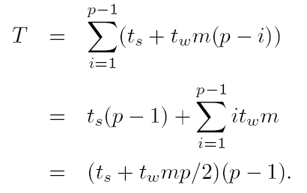
All-to-All Personalized Communication on a Ring: Cost
We have p – 1 steps in all.
In step i, the message size is m(p – i).
The total time is given by:
The t_{w} term in this equation can be reduced by a factor of 2 by communicating messages in both directions.

Slide 54
All-to-All Personalized Communication on a Mesh
Each node first groups its p messages according to the columns of their destination nodes.
All-to-all personalized communication is performed independently in each row with clustered messages of size m√p.
Messages in each node are sorted again, this time according to the rows of their destination nodes.
All-to-all personalized communication is performed independently in each column with clustered messages of size m√p.

Slide 55
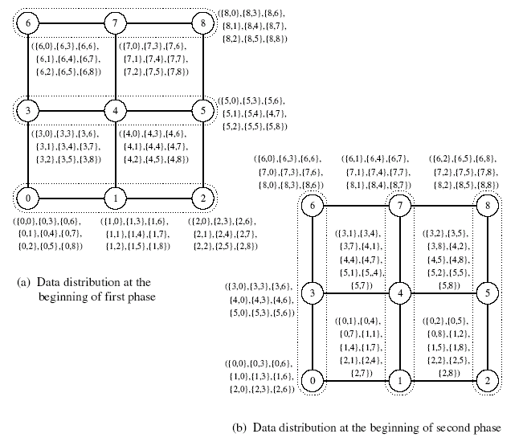
All-to-All Personalized Communication on a Mesh
The distribution of messages at the beginning of each phase of all-to-all personalized communication on a 3 x 3 mesh. At the end of the second phase, node i has messages ({0,i},…,{8,i}), where 0 ≤ i ≤ 8. The groups of nodes communicating together in each phase are enclosed in dotted boundaries.

Slide 56

All-to-All Personalized Communication on a Mesh: Cost
Time for the first phase is identical to that in a ring with √p processors, i.e., (t_{s} + t_{w}mp/2)(√p – 1).
Time in the second phase is identical to the first phase. Therefore, total time is twice of this time, i.e.,
It can be shown that the time for rearrangement is less much less than this communication time.

Slide 57
All-to-All Personalized Communication on a Hypercube
Generalize the mesh algorithm to log p steps.
At any stage in all-to-all personalized communication, every node holds p packets of size m each.
While communicating in a particular dimension, every node sends p/2 of these packets (consolidated as one message).
A node must rearrange its messages locally before each of the log p communication steps.

Slide 58
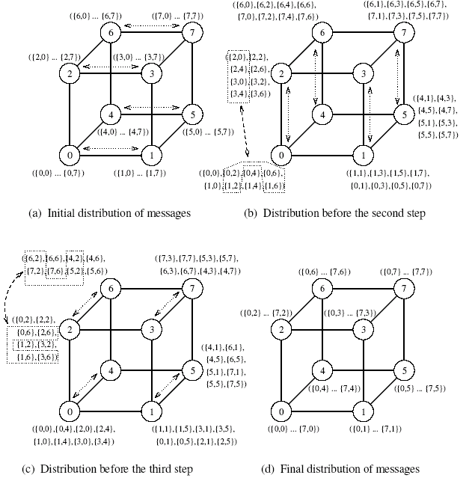
All-to-All Personalized Communication on a Hypercube
An all-to-all personalized communication algorithm on a three-dimensional hypercube.

Slide 59

All-to-All Personalized Communication on a Hypercube: Cost
We have log p iterations and mp/2 words are communicated in each iteration. Therefore, the cost is:
This is not optimal!

Slide 60
All-to-All Personalized Communication on a Hypercube: Optimal Algorithm
Each node simply performs p – 1 communication steps, exchanging m words of data with a different node in every step.
A node must choose its communication partner in each step so that the hypercube links do not suffer congestion.
In the j^{th} communication step, node i exchanges data with node (i XOR j).
In this schedule, all paths in every communication step are congestion-free, and none of the bidirectional links carry more than one message in the same direction.

Slide 61
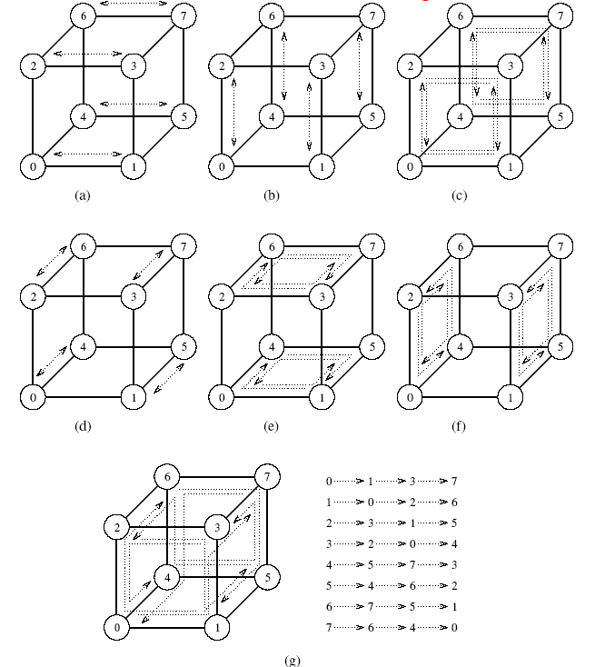
All-to-All Personalized Communication on a Hypercube: Optimal Algorithm
Seven steps in all-to-all personalized communication on an eight-node hypercube.

Slide 62
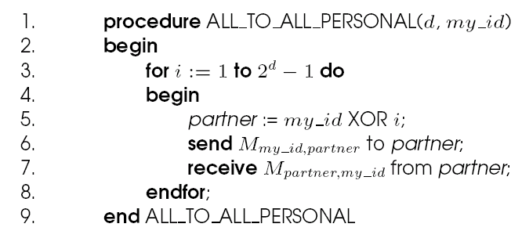
All-to-All Personalized Communication on a Hypercube: Optimal Algorithm
A procedure to perform all-to-all personalized communication on a d-dimensional hypercube. The message M_{i,j} initially resides on node i and is destined for node j.

Slide 63

All-to-All Personalized Communication on a Hypercube: Cost Analysis of Optimal Algorithm
There are p – 1 steps and each step involves non-congesting message transfer of m words.
We have:
This is asymptotically optimal in message size.

Slide 64
Circular Shift
A special permutation in which node i sends a data packet to node (i + q) mod p in a p-node ensemble
(0 ≤ q ≤ p).

Slide 65

Circular Shift on a Mesh
The implementation on a ring is rather intuitive. It can be performed in min{q,p – q} neighbor communications.
Mesh algorithms follow from this as well. We shift in one direction (all processors) followed by the next direction.
The associated time has an upper bound of:

Slide 66
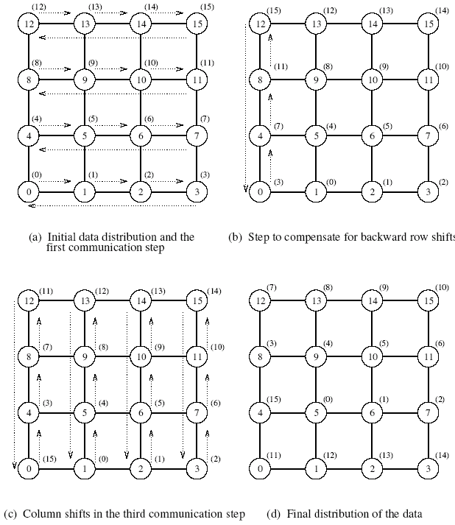
Circular Shift on a Mesh
The communication steps in a circular 5-shift on a 4 x 4 mesh.

Slide 67


Circular Shift on a Hypercube
Map a linear array with 2^{d} nodes onto a d-dimensional hypercube.
To perform a q-shift, we expand q as a sum of distinct powers of 2.
If q is the sum of s distinct powers of 2, then the circular q-shift on a hypercube is performed in s phases.
The time for this is upper bounded by:
If E-cube routing is used, this time can be reduced to

Slide 68
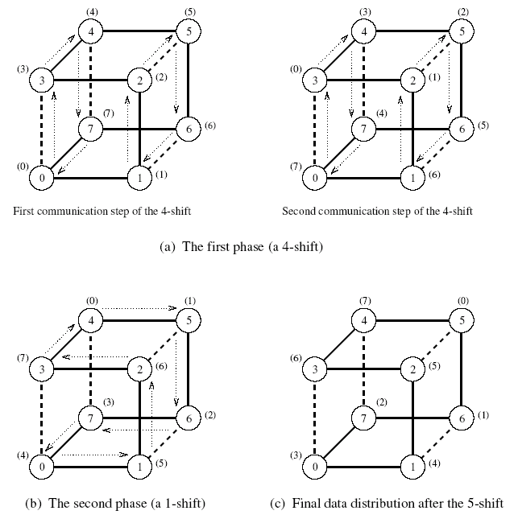
Circular Shift on a Hypercube
The mapping of an eight-node linear array onto a three-dimensional hypercube to perform a circular 5-shift as a combination of a 4-shift and a 1-shift.

Slide 69
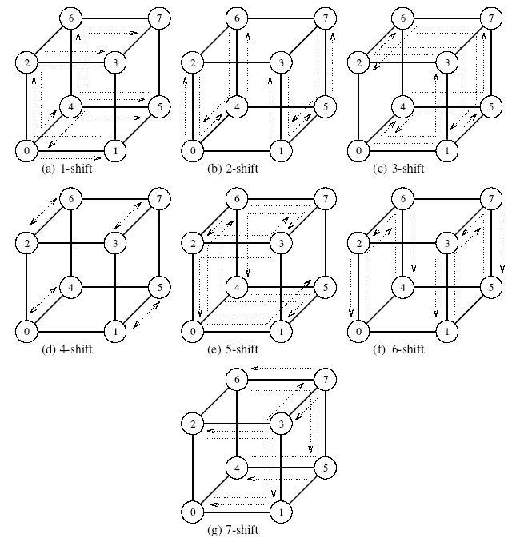
Circular Shift on a Hypercube
Circular q-shifts on an 8-node hypercube for 1 ≤ q < 8.

Slide 70
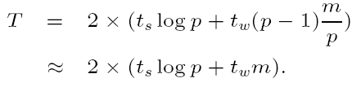
Improving Performance of Operations
Splitting and routing messages into parts: If the message can be split into p parts, a one-to-all broadcast can be implemented as a scatter operation followed by an all-to-all broadcast operation. The time for this is:
All-to-one reduction can be performed by performing all-to-all reduction (dual of all-to-all broadcast) followed by a gather operation (dual of scatter).

Slide 71
Improving Performance of Operations
Since an all-reduce operation is semantically equivalent to an all-to-one reduction followed by a one-to-all broadcast, the asymptotically optimal algorithms for these two operations can be used to construct a similar algorithm for the all-reduce operation.
The intervening gather and scatter operations cancel each other. Therefore, an all-reduce operation requires an all-to-all reduction and an all-to-all broadcast.

